Slide 1




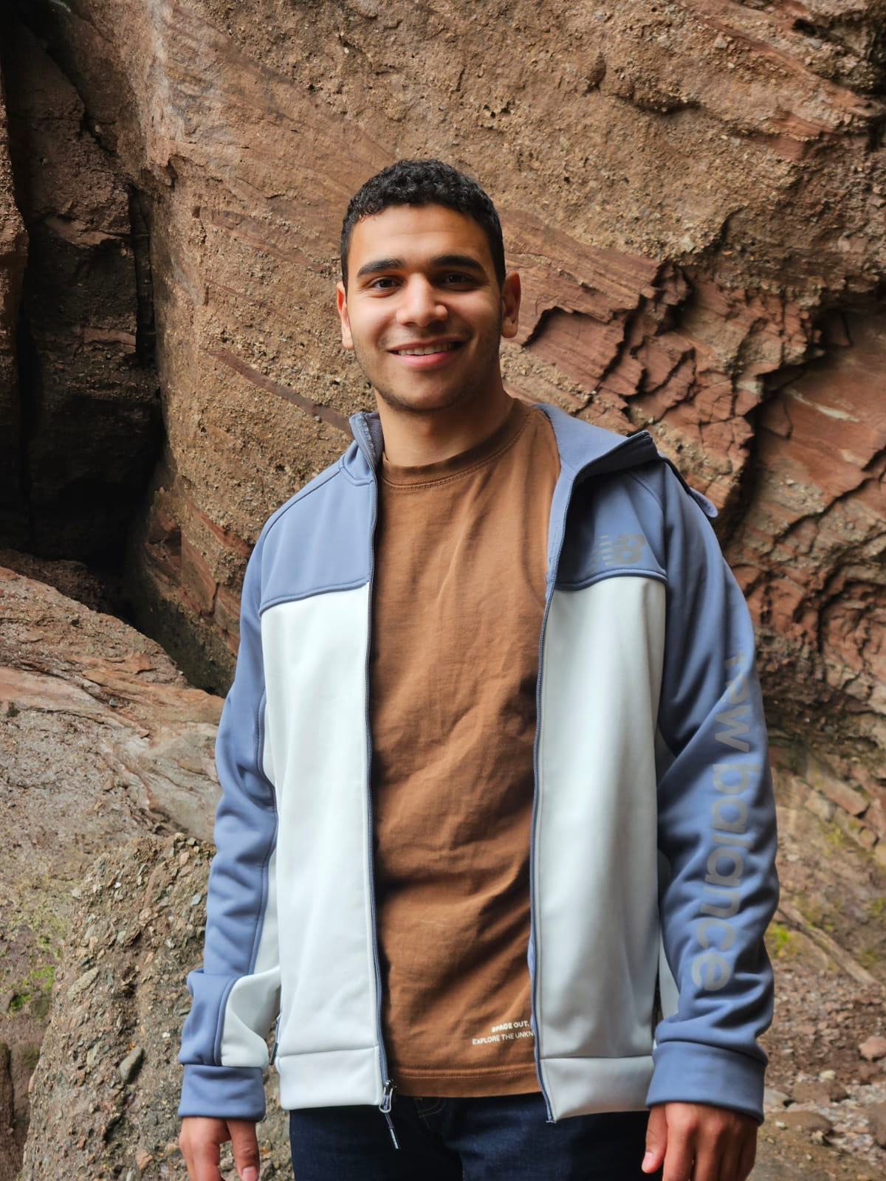
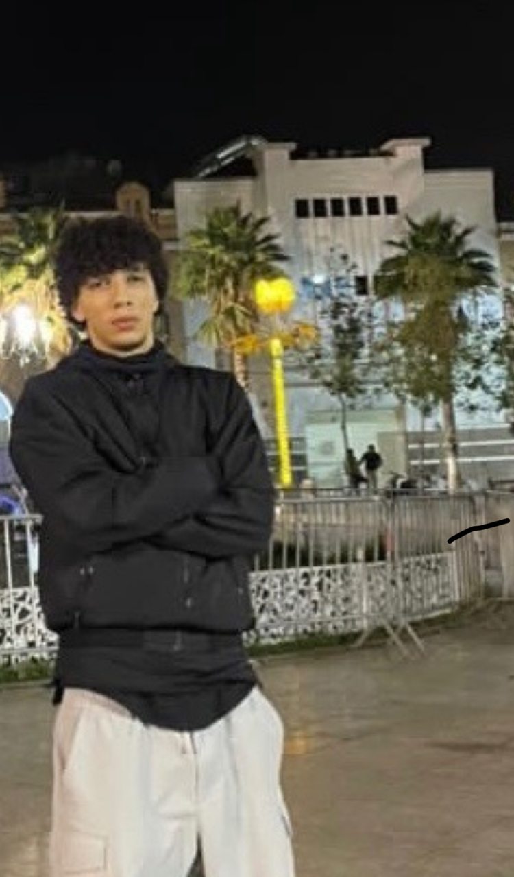
LHDiff – Line Mapping and Change Tracking Tool
COMP-3110 – Software Engineering
Instructor: Muhammad Asaduzzaman
Group Members
Omar Kayali
Albert Qyli
Badr Kayyali
Salman Youssef
Youcef Teffahi
Software Engineering Group Project University of Windsor, Canada

